Slide 1
Quantum Espresso
NTHU @ ISC23

Slide 2
Quantum Espresso
Introduction
Quantum Espresso
an integrated suite of Open-Source computer codes for electronic-structure calculations and materials modeling at the nanoscale.
It is based on density-functional theory, plane waves, and pseudopotentials.
cp.x
a core component of the Quantum ESPRESSO distribution.
CP can perform Car-Parrinello molecular dynamics, including variable-cell dynamics
pw.x
a set of programs for electronic structure calculations within density functional theory and density functional perturbation theory, using plane wave basis sets and pseudopotentials.

Slide 3
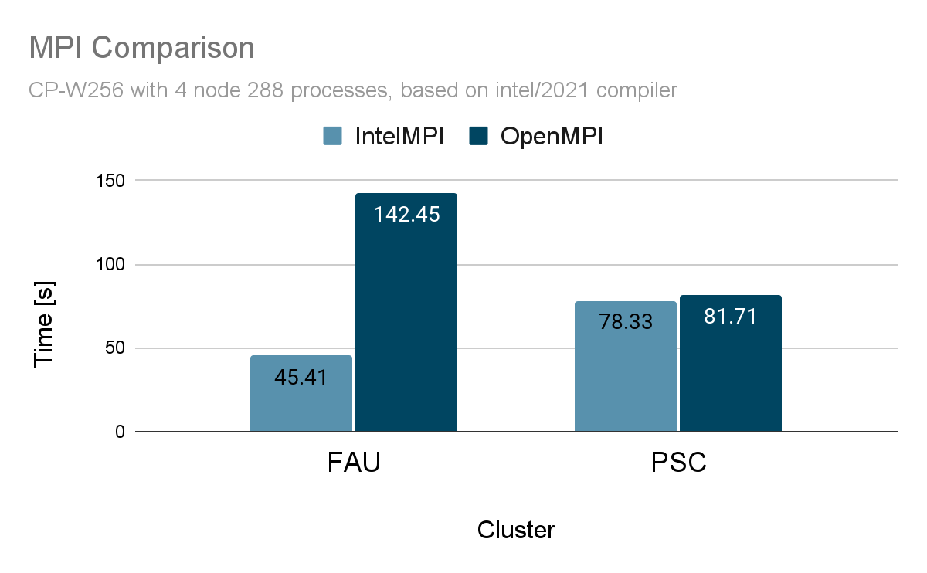
Compiler and MPI
Library Selection
IntelMPI is faster on both cluster

Slide 4

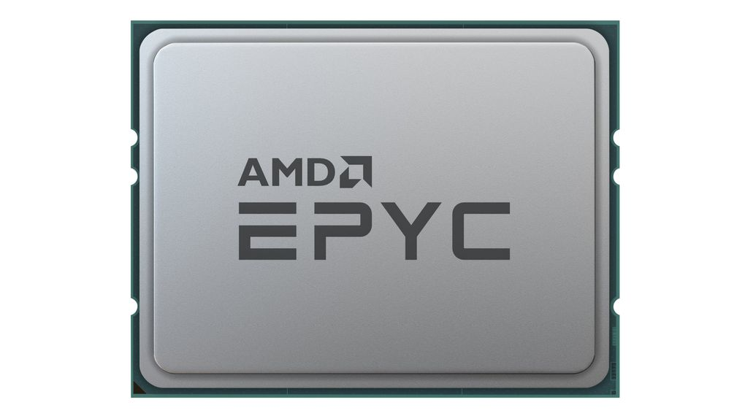
Compiler and MPI
Library Selection
FAU CPU : Intel(R) Xeon(R) Platinum 8360Y CPU @ 2.40GHz
PSC CPU : AMD EPYC 7742 64-Core Processor
Intel compiler and Intel MPI are better suited to Intel CPUs.

Slide 5
Optimization of parameters
Performance Evaluation & Application Optimization
Problem :
Failed to use more than 200 processes for CP-W256, and 192 for supercell_11layer
Solution :
-nb : enable bands parallelization, allow to use up to 200 * nb processes
-pd true : enable pencil decomposition

Slide 6
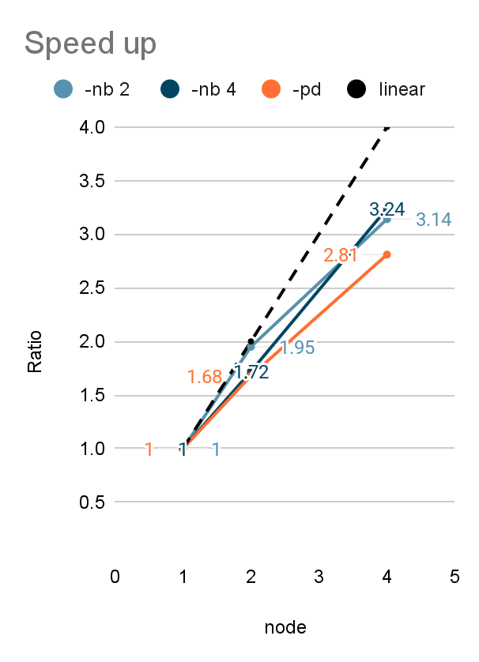
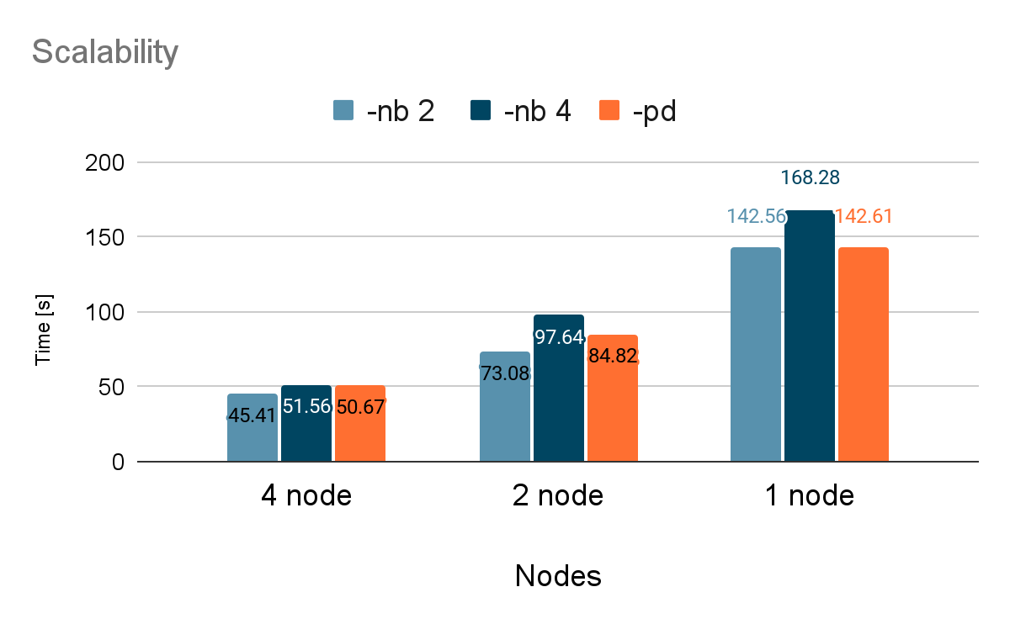
CP-W256 Scalability on FAU
Performance Evaluation & Application Optimization
Ideal scalability
With three different setting still linear with number of nodes

Slide 7
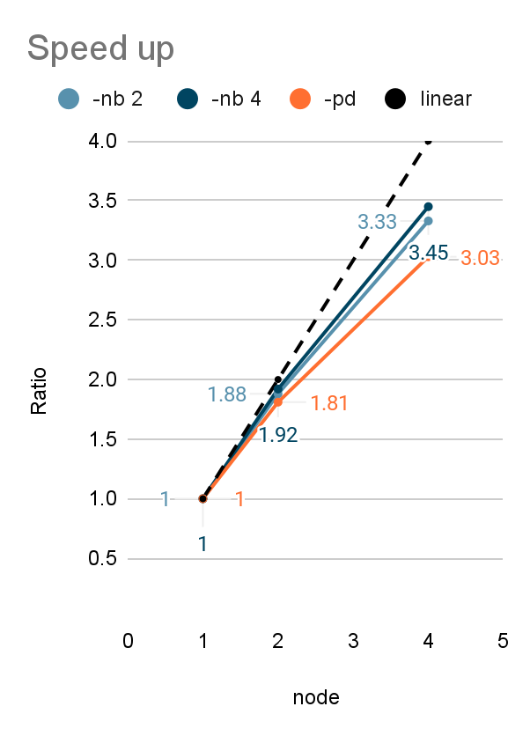
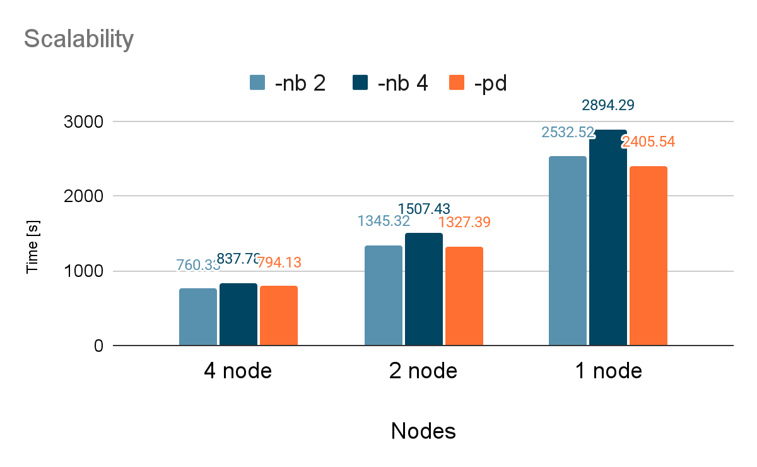
Supercell_11layer Scalability on FAU
Performance Evaluation & Application Optimization
Ideal scalability
With three different setting still linear with number of nodes

Slide 8
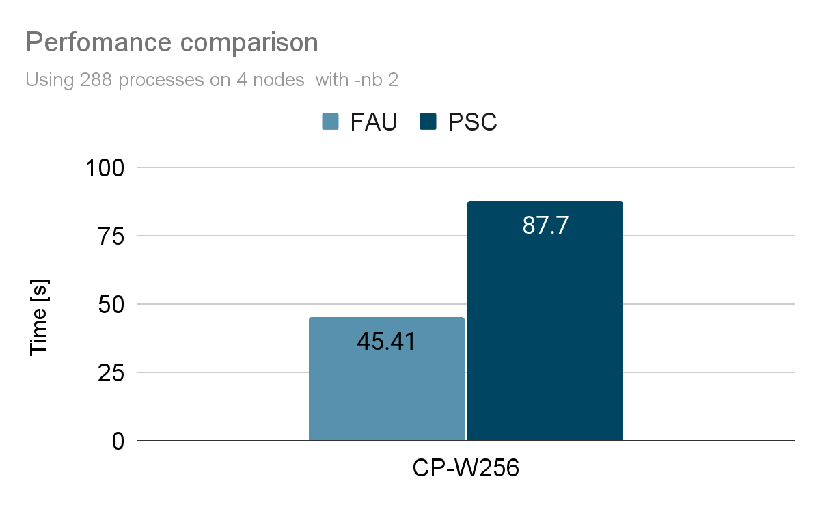
Performance comparison
FAU vs PSC
CP-W256
FAU is faster than PSC

Slide 9
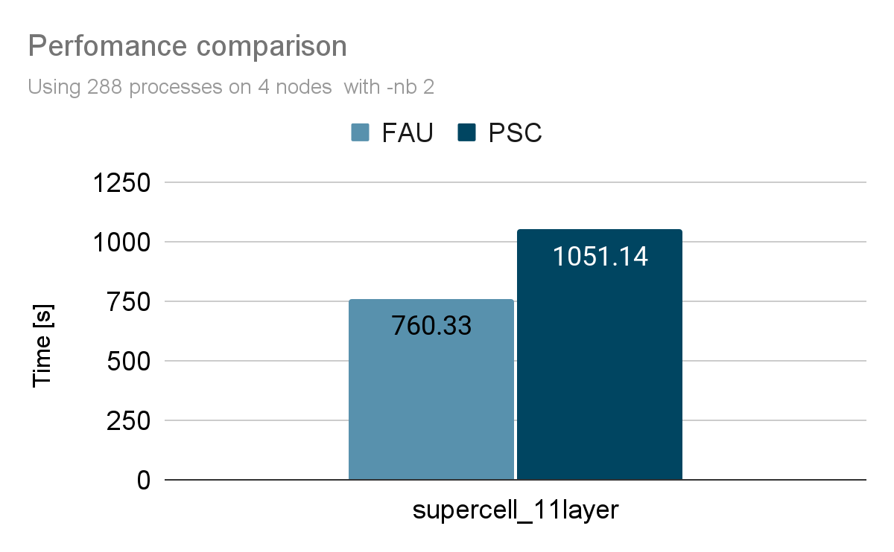
Performance comparison
FAU vs PSC
Supercell_11layer
FAU is faster than PSC

Slide 10
Performance comparison
FAU vs PSC
Reason :
FAU has better computing power than PSC.
Clock rate :
FAU : Intel(R) Xeon(R) Platinum 8360Y CPU => 2.40GHz
PSC : AMD EPYC 7742 64-Core Processor => 2.25GHz

Slide 11
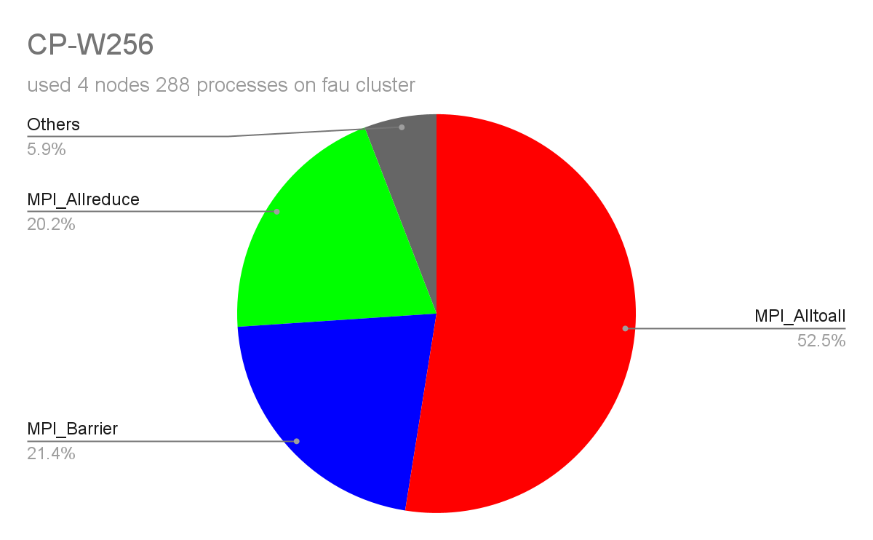
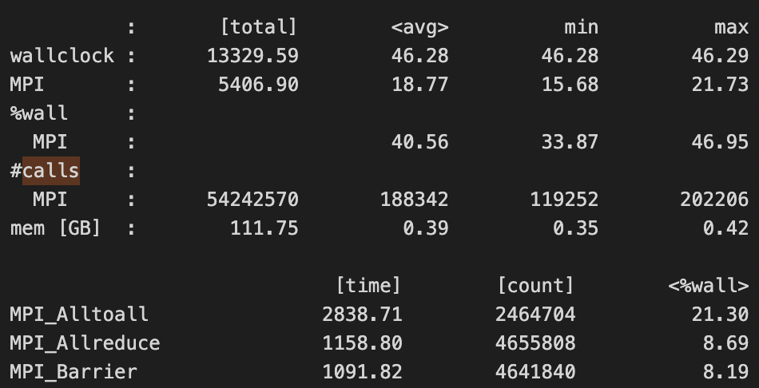
Profiling result
CP-W256
Profiling
MPI time of 3 main calls
3 Main MPI calls | MPI_Alltoall | MPI_Barrier | MPI_Allreduce

Slide 12
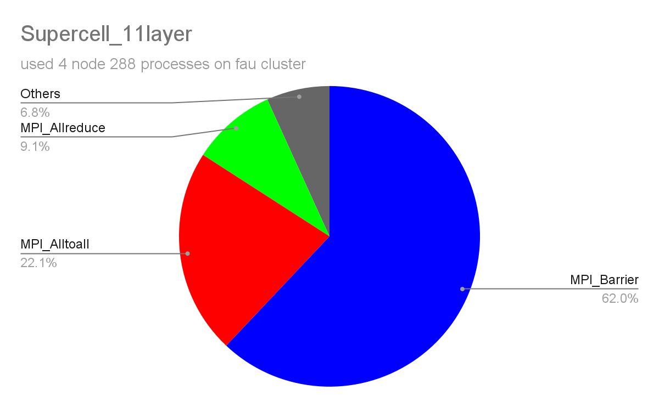
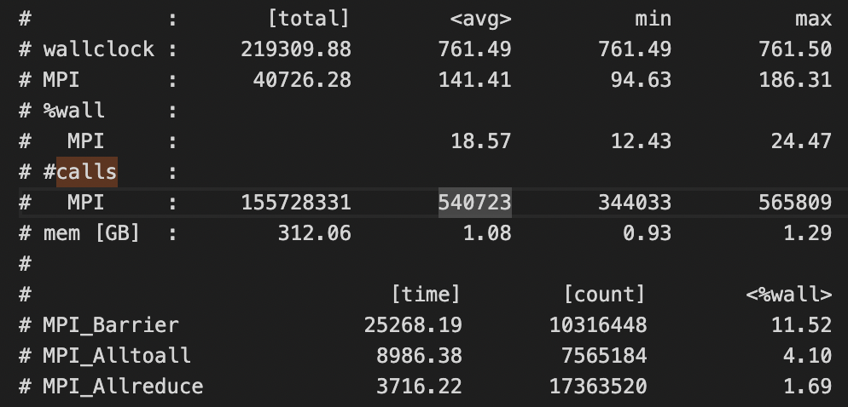
Profiling result
supercell_11layer
Profiling
MPI time of 3 main calls
3 Main MPI calls | MPI_Barrier | MPI_Alltoall | MPI_Allreduce

Slide 13
Profiling result
Profiling
most - - - - - - - - - - - - - - - - - - - - - - - - - - - - - - - - - - - - - - - - - less
CP-W256 | MPI_Alltoall | MPI_Barrier | MPI_Allreduce
supercell_11layer | MPI_Barrier | MPI_Alltoall | MPI_Allreduce
The main differences are between MPI_Alltoall and MPI_Barrier
MPI_Alltoall : Sends data from all to all processes
MPI_Barrier : Blocks until all processes in the communicator have reached this routine
Guess : Larger input file requires more data synchronization between processes

Slide 14
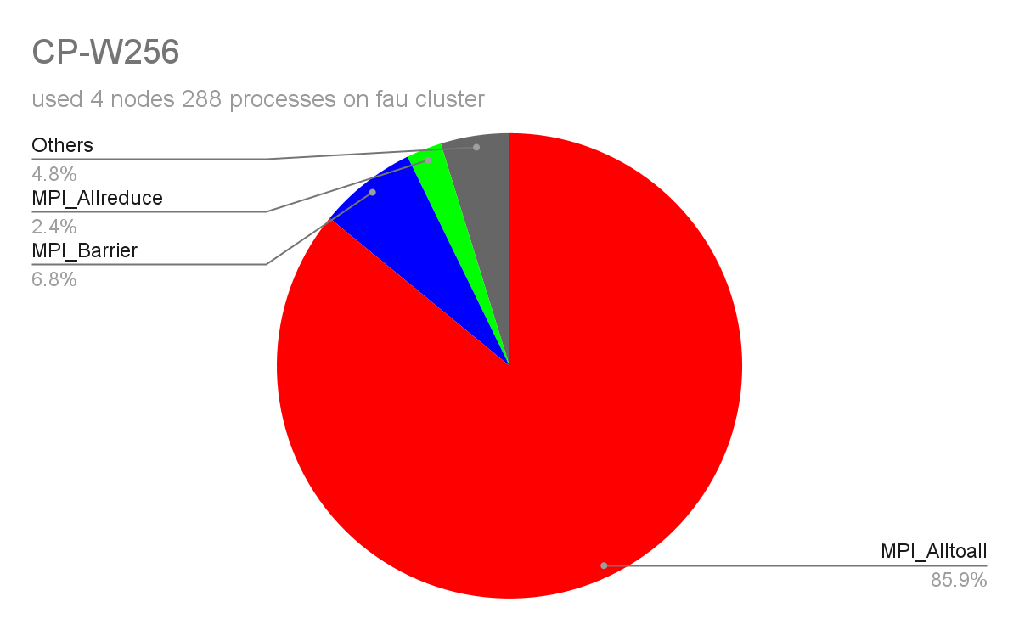
FAU 2 parameter comparison
Profiling
-nb 2
-pd true
Pencil decomposition increase the usage MPI_Alltoall
Bands parallelization used MPI_Allreduce a lot more than pencil decomposition
Both have a decent amount of MPI_Barrier

Slide 15
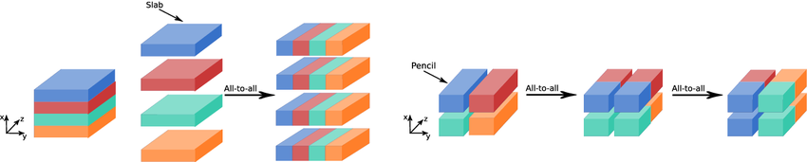
FAU 2 parameter comparison
Profiling
According to the image, we know that the pencil decomposition has more All-to-all calls than slab decomposition

Slide 16
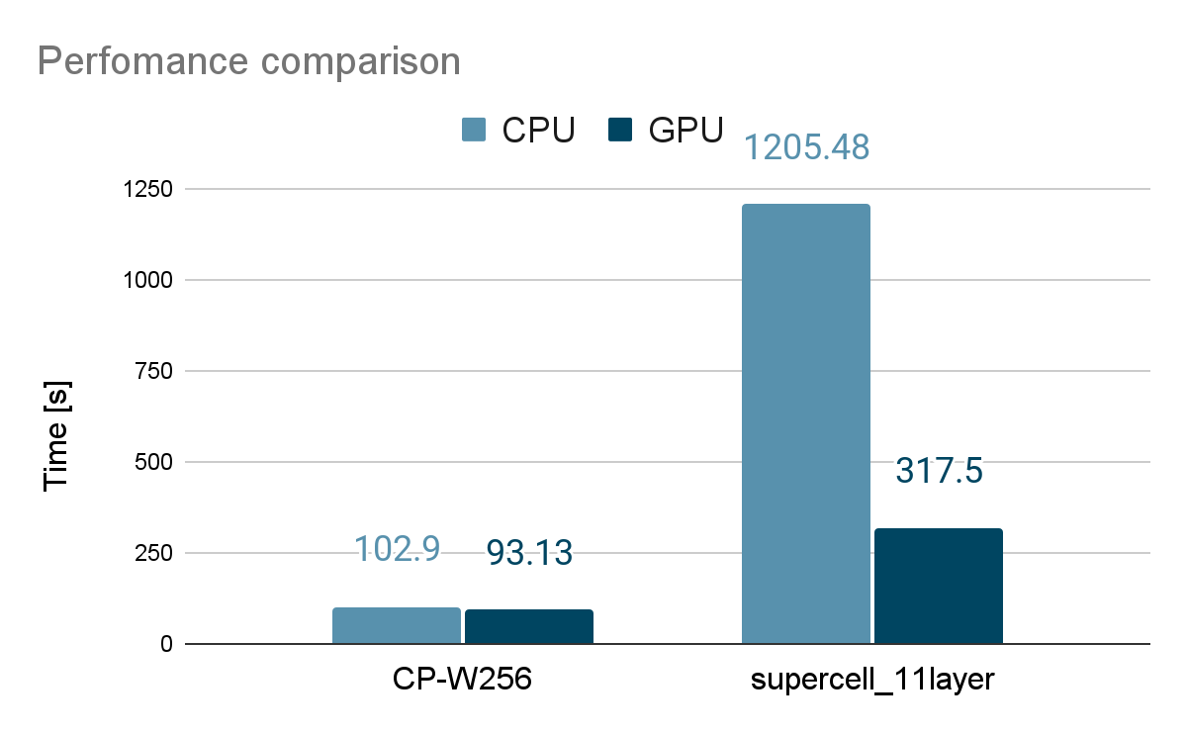
GPU acceleration
GPU
CPU :
512 processes on 4 nodes
-nb 4
hpcx
GPU :
4 V100 GPUs on 1 node
nvhpc

Slide 17
GPU acceleration
GPU
Larger input
=> GPU acceleration gets More obvious
Speed up
CP-W256 : 1.1049
supercell_11layer : 3.7967

Slide 18
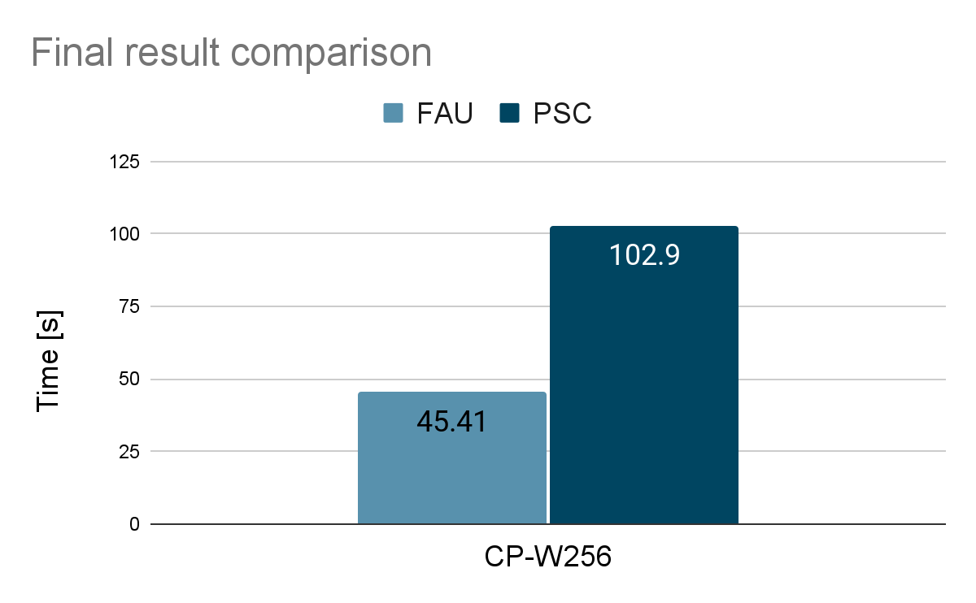
Final result of CP-W256
Result
FAU | icc + intelMPI, -nb 2
PSC | icc + hpcx, -nb 4
FAU | 288 processes => 45.41s
PSC | 512 processes => 102.90s

Slide 19
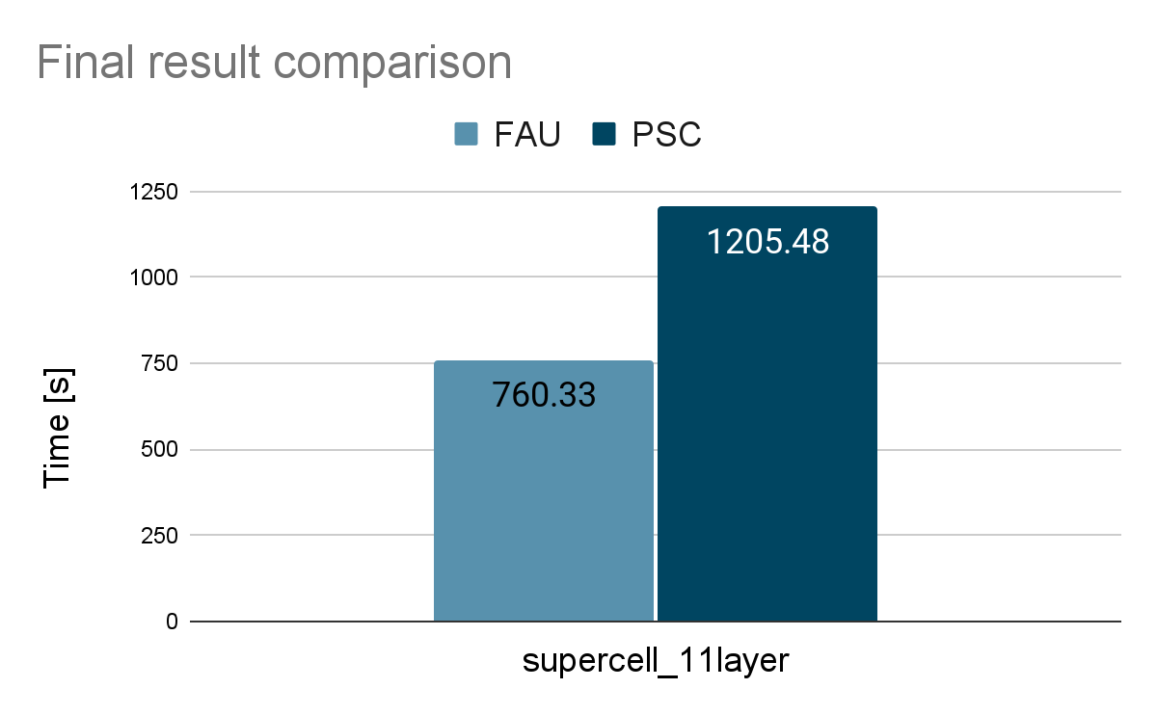
Final result of supercell_11layer
Result
FAU | icc + intelMPI, -nb 2
PSC | icc + hpcx, -nb 4
FAU | 288 processes => 760.33s
PSC | 512 processes => 1205.48s

Slide 20
Thanks
NTHU @ ISC23

